Slide 1
Valuation: Tips and Tricks and Big Money
Phyllis Leah Speser, J.D., Ph.D.
Foresight Science & Technology
www,ForesightST.com

Slide 2
What is Valuation?
A technique for calculating the value of assets* deployed or held in reserve
*something useful for making money

Slide 3
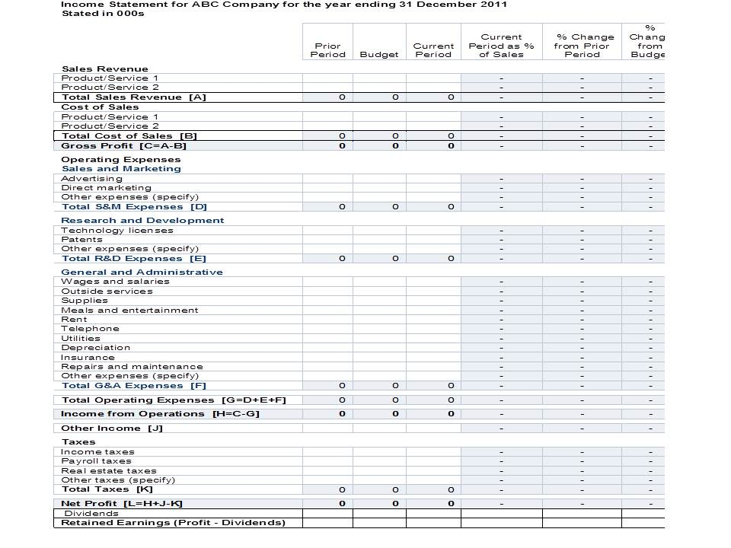
Sample Income Statement
Some percentagebased on contribution to product revenues and costs
http://johanhburger.com/understanding-the-income-statement/

Slide 4
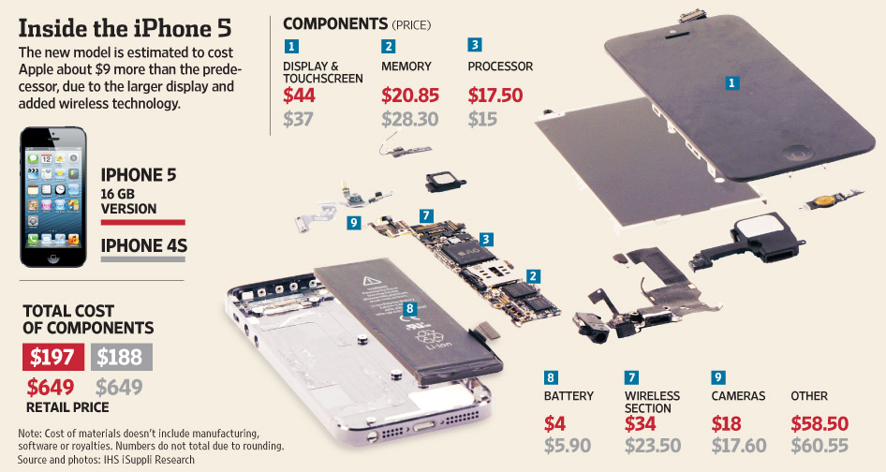
iPhone® cost and price comparison
https://www.iphoneincanada.ca/iphone-5-2/here-is-a-breakdown-of-iphone-5-component-costs-photo/

Slide 5
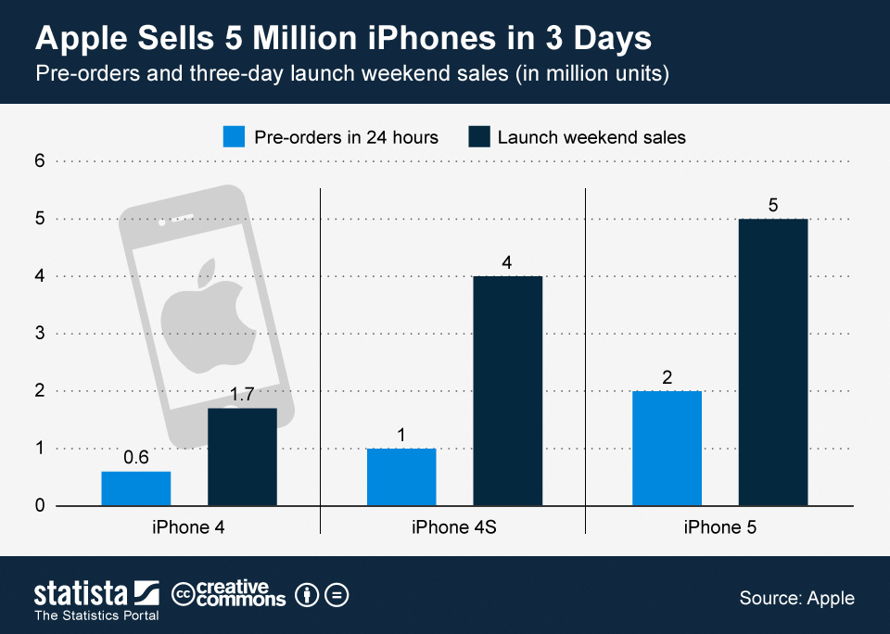
Sales Data
https://www.statista.com/chart/617/pre-orders-and-three-day-launch-weekend-sales-of-apples-iphone-4-4s-and-5/

Slide 6
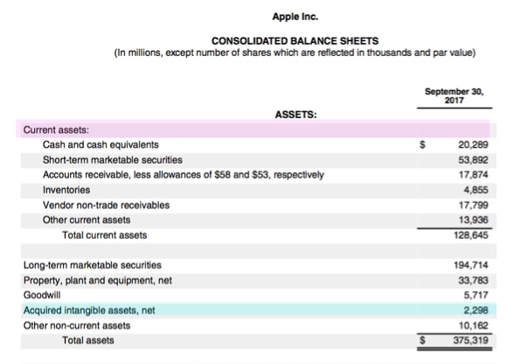
Sample Balance Sheet

Slide 7
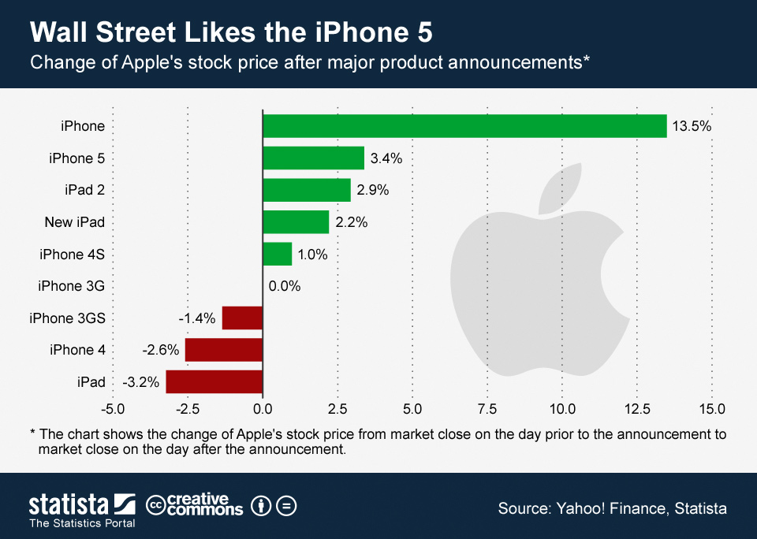
Impact of New Technology Based Product on Stock Price

Slide 8
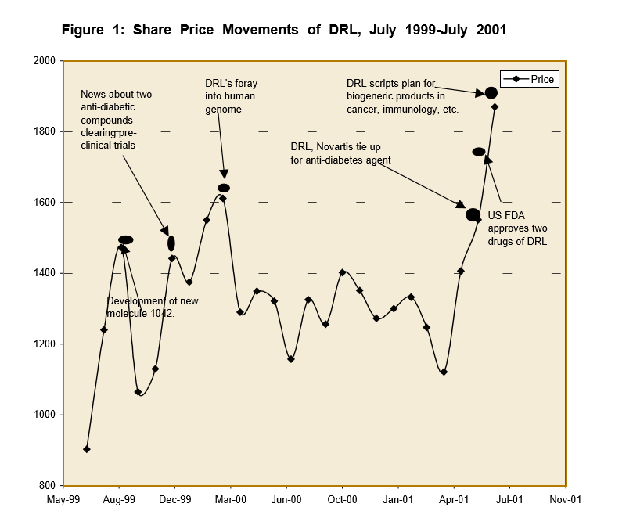
Pharma Example
http://www.vikalpa.com/pdf/articles/2003/2003_apr_jun_061_073.pdf

Slide 9
Tip One
Value is what shows up, or will show up, on the balance sheet or income statemen.

Slide 10
The method of valuation we do reflects the reason for doing it
High
Past
Present
Future
Price a Venture
License
or Alliance
Sell to Inventor,
Abandon,
or Assign for
anti-Patent Troll
use
Low

Slide 11
The basis of value is utility
Utility is rooted in human needs
Utility is intersubjective when rooted in shared human needs and experiences
Clearest shared needs are survival needs: water, food, shelter, clothing, etc.
The perception of beauty is affected by symmetry

Slide 12

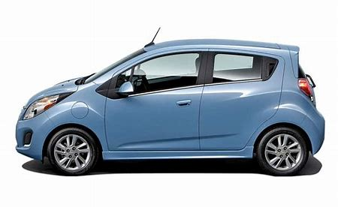
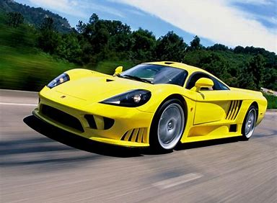
Trade is a way of enhancing utility
N x
=

Slide 13

Fair Market Value
Based on trading “goods”
Fair: both parties are equivalently better off after the trade in their own eyes due to marginal utility nof the good for each
Market: more than one trade has/is occurring
Value: the better off can be measured in terms of intersubjective utility, ideally using money

Slide 14

FMV is not “blind”
The value of a “good” is different for different people
The term “Market” in FMV presumes there are many real or simulated identical transactions
  Commodity model
  Market value is a statistical average
  A Market Day is the venue for determining value
  Custom goods have a market value via auction which simulates many transactions
Growth in number of players in technology transfer creates pseudo-commodities for the technology market

Slide 15
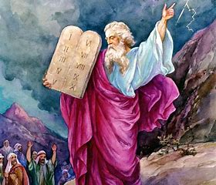
Tip Two:
The basis of valuation is figuring out how to present a number everyone else will think is fair

Slide 16
All valuation is based on satisficing
In open systems you cannot optimize
You can set one or more criteria and satisfice
There is no single best answer, but there are acceptable answers
There are better or worse acceptable answers
Herbert Simon’s bounded rationality

Slide 17
Karl Popper’s criteria for good scientific theory
A valuation is a hypothesis
Good theories make claims (hypotheses) that can be falsified. The more claims made, the easier the theory is to falsify.
Good theories are clear and precise. The terms are defined and universally understood.

Slide 18
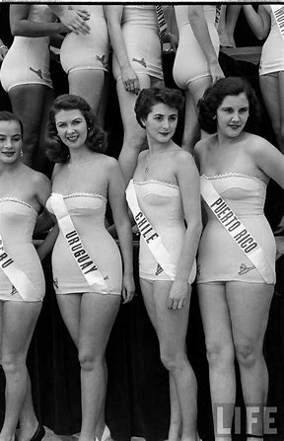
P-Beauty Contests and the Price of Stocks
It’s not who is objectively beautiful, it’s who everyone thinks will be beautiful.
"It is not a case of choosing those [faces] that, to the best of one's judgment, are really the prettiest, nor even those that average opinion genuinely thinks the prettiest. We have reached the third degree where we devote our intelligences to anticipating what average opinion expects the average opinion to be. And there are some, I believe, who practice the fourth, fifth and higher degrees." (Keynes, General Theory of Employment, Interest and Money, 1936).

Slide 19
When you only need a royalty rate
An agreed upon method for determining value suffices

Slide 20
We don’t need to estimate revenues, if all we need is an agreed upon royalty rate
The principle is the same even if we add upfront fees and milestone penalties
Aswath Damodaran: Much of the tedium [i.e. cost] in doing valuation comes from the necessity of estimating cash flows

Slide 21
Rules of Thumb for Royalty Rates
5% Rule
25% Rule

Slide 22
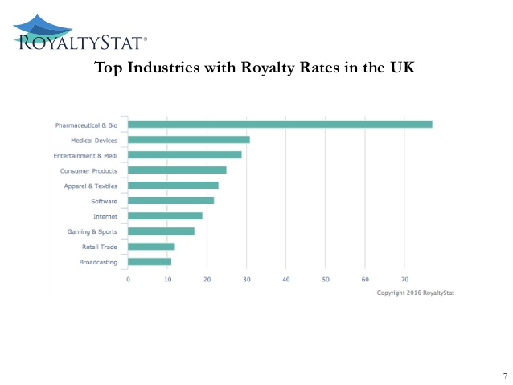
Comparables for Royalty Rates

Slide 23
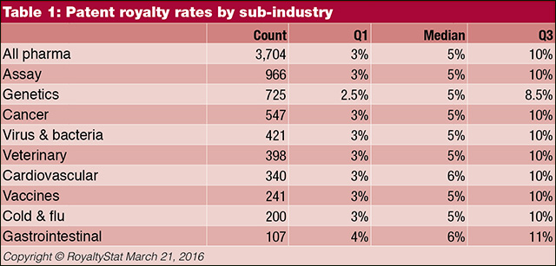
Targeted Comparables for Royalty Rates

Slide 24
Upfront Fees
What is the Upfront Fee
  Recoupment of patent costs?
  A prepayment of royalties due?
  A knowhow fee?
  An incentive to bring the technology licensed to market?
  Compensation for associated goodwill?
Knowhow fees
  Milestone payments in process technology contracts
  Substitute for a consulting contract
  Based on cost of labor

Slide 25
Tip Three
If you want to know the Probability of Beauty,
run a P-Beauty Contest

Slide 26
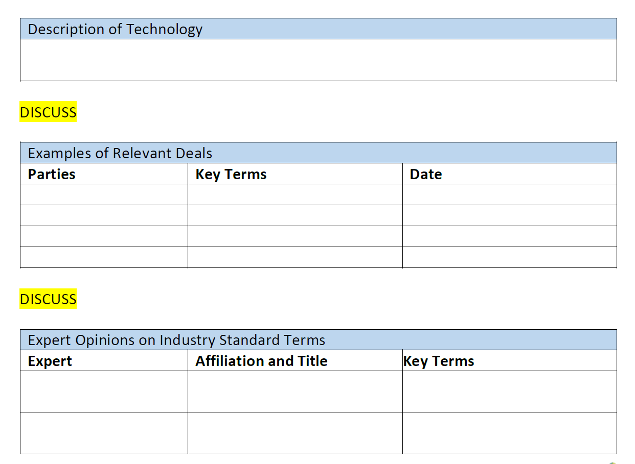
How to Run a P-Beauty Contest

Slide 27
Foresight Royalty Rate Calculator
Any numbers in green found in the following fields can be changed and will be reflected in the tables below
Factor | Rate | Weight | Impact
Sample Industry Norm | 5.0%
Significance (Breakthrough add 5-10%, Major add 0-5%%, Minor subtract 0-3% | 4.0% | 0.1 | 0.40%
Refinement/Maturity of Technology (High add, Low subtract) | 2.0% | 0.1 | 0.20%
Breadth and Strength of IP Protection (Yes add, No subtract) | 0.0% | 0.1 | 0.00%
Portfolio, Not Single Patent Being Licensed (Yes add,No 0, Subtract if Stacking Needed) | 0.0% | 0.1 | 0.00%
Exclusivity of License (Exclusive: add 5-10%, Normal: remain 0, Non-Exclusive: subtract 5-10%) | 0.0% | 0.1 | 0.00%
Exclusive Market Position in Field of Use Gained (Yes add, No subtract) | 2.0% | 0.1 | 0.20%
Immediate Utility in Market (Yes add, No subtract) | 2.0% | 0.1 | 0.20%
Commercially Successful (Already Successful in Market add, Not Yet Proven in Market subtract) | 0.0% | 0.1 | 0.00%
Competition Exists That Will Inhibit Ability to Exploit (Yes subtract, No add) | 1.0% | 0.1 | 0.10%
Foreign Rights (Yes add, No subtract) | -1.0% | 0.1 | -0.10%
Sales Conveyed or Highly Likely (Yes add, No subtract) | 1.5% | 0.1 | 0.15%
Duration (Over Ten Years add, Under Three Years subtract) | 2.0% | 0.1 | 0.20%
Upfront Payment Required (Yes subtract, No or Conditional add, Standard neutral) | 0.0% | 0.1 | 0.00%
Minimum Royalties (Yes subtract, no add, Standard neutral) | 0.0% | 0.1 | 0.00%
Know-How Included in Deal (Yes add, No subtract, Standard neutral) | 1.0% | 0.1 | 0.10%
Support/Training Provided After Initial Transfer (Yes add, No subtract, Standard neutral) | 0.0% | 0.1 | 0.00%
Maintenance and Enforcement Burden (Licensee subtract, Licensor add, Standard neutral) | 0.0% | 0.1 | 0.00%
Exposure to Liability (Yes subtract, No add, Standard neutral) | 0.0% | 0.1 | 0.00%
Add to Industry Norm |  |  | 1.45%
ADJUSTED RATE |  |  | 6.45%
Georgia-Pacific v. US Plywood Case 318 F. Supp. 1116 (S.D.N.Y. 1970)

Slide 28

Tip Four
To know what others are likely to find beautiful, you have to consider what they will view as plausible evidence for beauty

Slide 29
Value on the Income Statement
Net Present Value

Slide 30
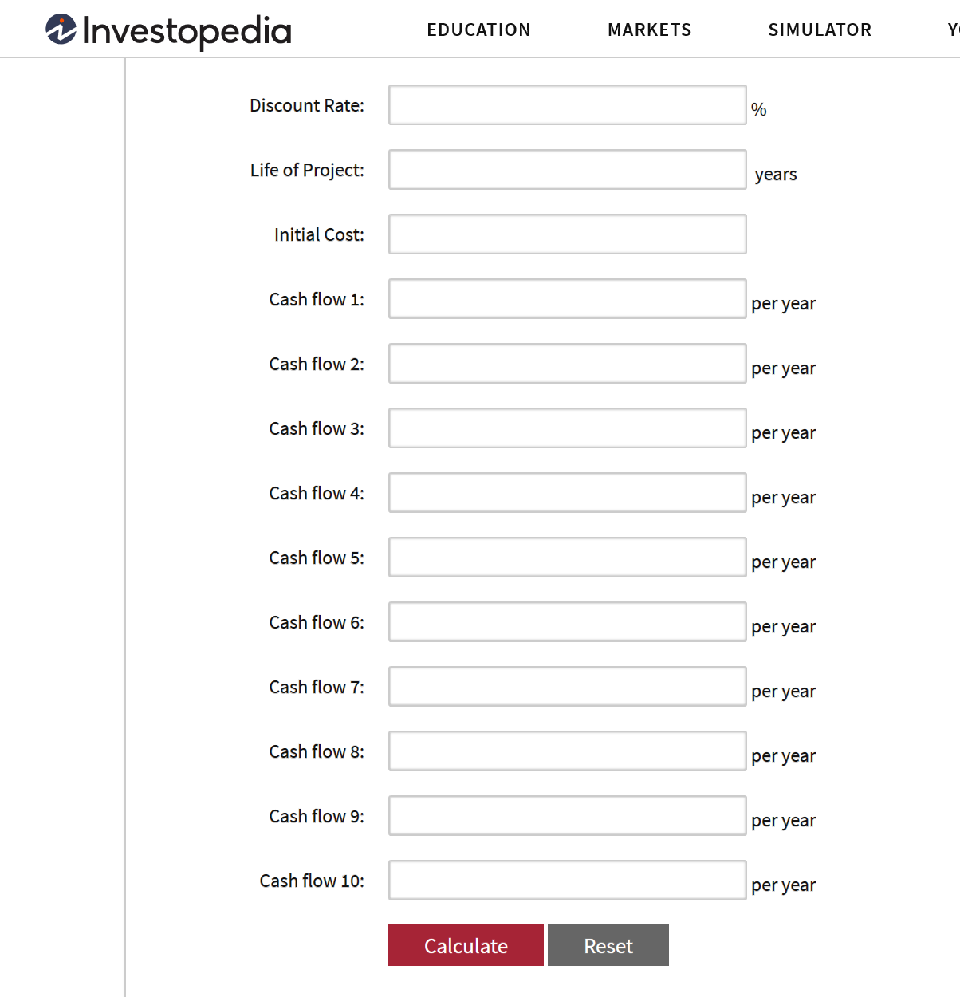
NPV as a component of Gross Profit or EBIT

Slide 31
Revenues
(Life or death needs such as health,
environment, or military requirements and
aesthetics/taste for consumer items are the exceptions. )

Slide 32
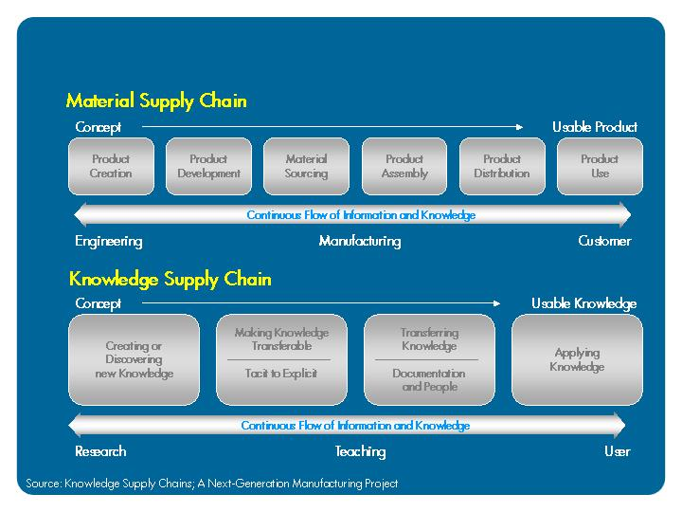
Insertion into a Supply Chain
32

Slide 33
Revenues are always Guesstimates

Slide 34
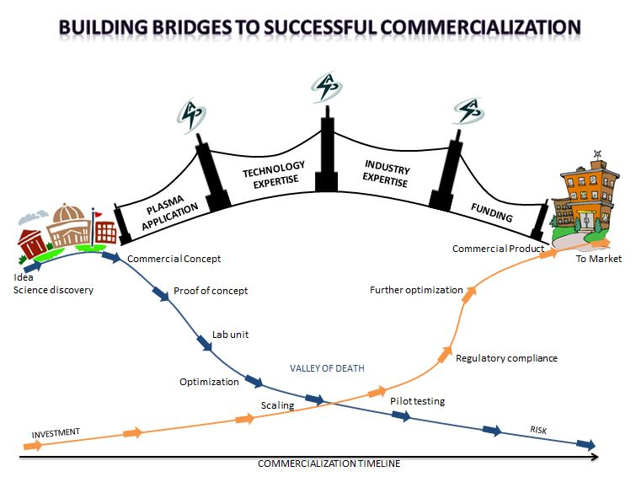
The level of uncertainty is related to the TRL
https://www.advancedplasmasolutions.com/for-investors/

Slide 35
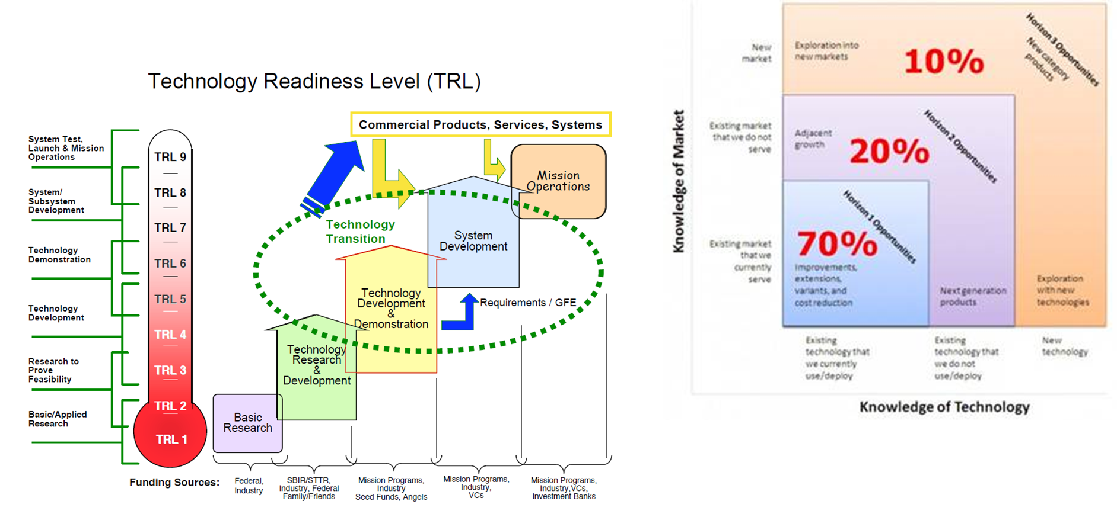
Generations and technology insertion into supply chains

Slide 36
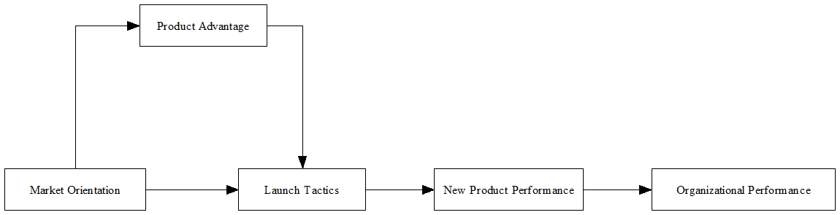
Determinates of Revenues

Slide 37
Estimating Revenues
Competitive Advantage
Determine What IP or Product is being Sold
Find the End-User
Determine Competitive Advantage
Estimate the Demand at a Given Price
Calculate Revenues
Market Orientation
Substitutes
End-User Needs
Technology
Buyers
Launch Tactics (4Ps)

Slide 38
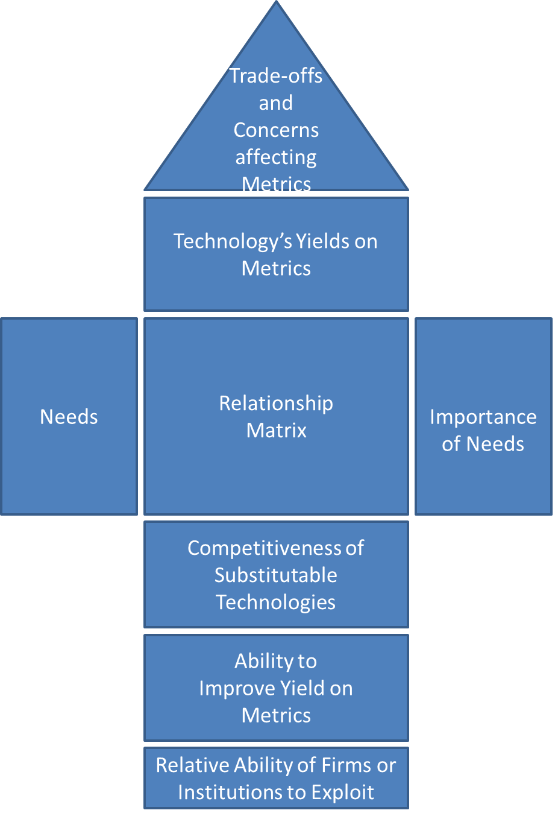
Competitive
Advantage
38
Your Technology
The Market
Your Competition
Your Target

Slide 39

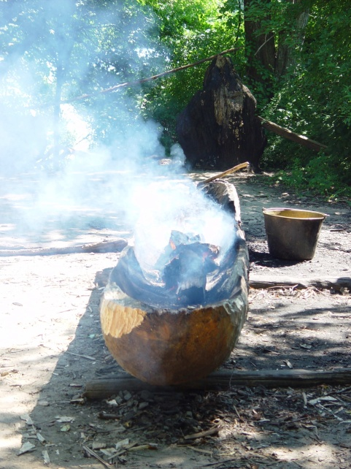
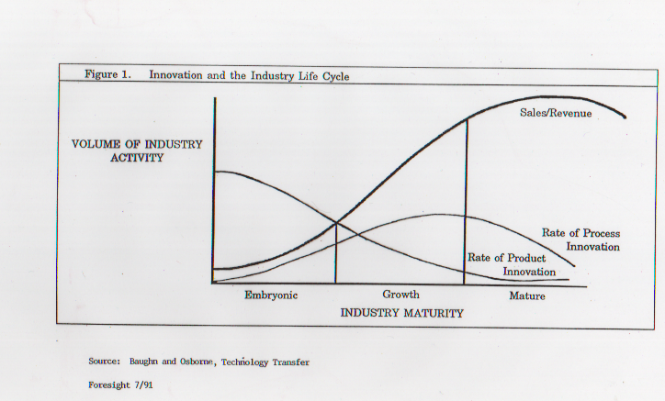
Estimating Revenues Based on Dominate Design and Features and Functionality
Product Innovation Stage
  Bundle of Features
  Standard User Interface
Process Innovation Stage
  Eliminate Steps
  Improve Reliability
  Improve Efficiency of Resource Use

Slide 40
A Products Value is Constrained by the Dominant Design and its Stability
Bohn Knowledge Level
Skills/Know-how
Utility ≈ Value
Extension
Extension
Core
Enabling
Strategic
Extension
Competing
Enabling
Time
40

Slide 41
Tip Five
Use the relationship of this technology to the dominant design and the stability of that design to estimate total potential revenues (addressable market size)

Slide 42
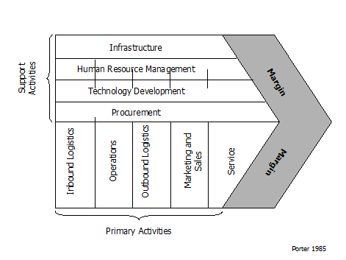
Costs
G&A
Revenues
Cost of Goods Sold

Slide 43
Cash Flow Analysis
The substantive process drives the cost calculation
The cost calculation, together with the revenue projections, drives the net value
43

Slide 44
Guesstimating Discount Rates
Risk Level Approximate DR(%) Description
Risk Free 10-18 Existing product, high demand,
building more of the same
Very Low Risk 15-20 New well understood technology
for an existing product
Low Risk 20-30 New features, well understood technology
into an existing market
Moderate Risk 25-35 New product, well understood technology
into market with competition
High Risk 30-40 New product, not well understood technology into an existing market.
Very High Risk 35-45 New product, new technology, new market
Extremely High Risk 50-70 New company, unproven technology, new market
Source: Richard Razgaitis, Early Stage Technology
44

Slide 45
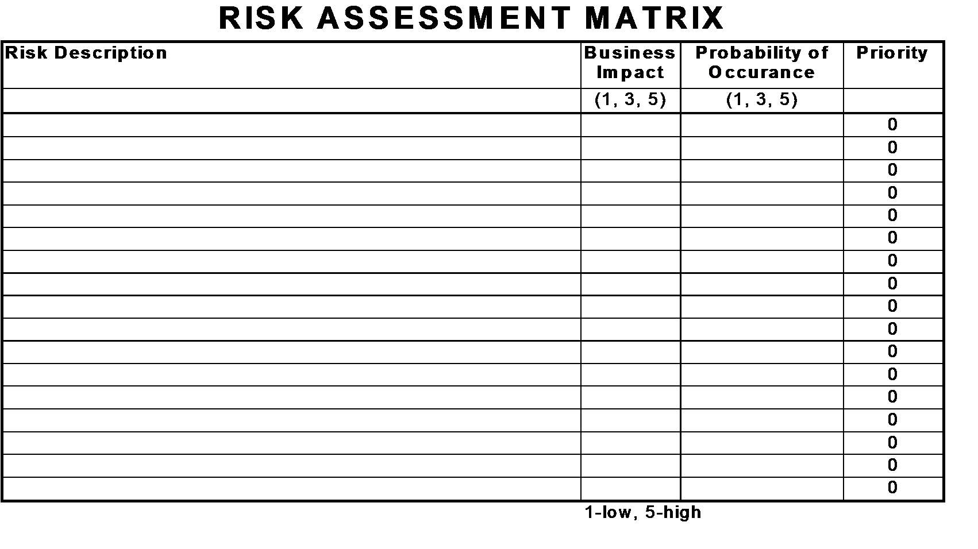
Discounting is identifying risks that defer income or raise costs
Economic Affect
Multiplier
Focus on the Significant Risks
45

Slide 46
Type of Risk for Determining the Discount Rate
Step Function Risks
  Technical
  Firm Specific
  Regulatory
Probability Distribution Risks
  IP
  Market

Slide 47
Tip Seven
Use different discount rates over time to reflect step function risks
Use Monte Carlo simulations to reflect probabilistic risks

Slide 48
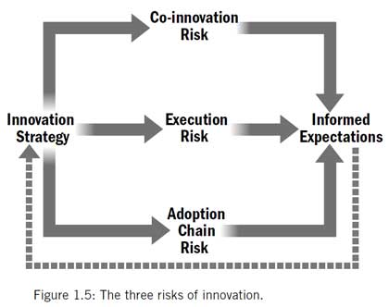
Locus of Risk
Co-Innovation: Collaboration and Technology Maturation
Execution: Supply Manufacturing, Marketing, Customer Support
Adoption Chain: Communication Channels, End-User Internal
Adner, The Wide Lens

Slide 49
Stakeholder analysis helps quantify risk
STAKEHOLDER ANALYSIS
Level of Commitment | People or Group
 | Co-Innovation | Execution | Adoption
Enthusiastic |  | O
Helpful | O | X | O
Compliant
Hesitant |  |  | X
Indifferent
Uncooperative
Opposed | X
Hostile
Key: |  | © 2017 KnowWare
O - Level Necessary for Success
X - Current Level
Spreadsheet in
QI Macros

Slide 50
Tip Eight
Controlling or mitigating risk reduces ther discount rate

Slide 51
IP Risk: Freedom to Operate or Monopolize
Ease of Use

Slide 52
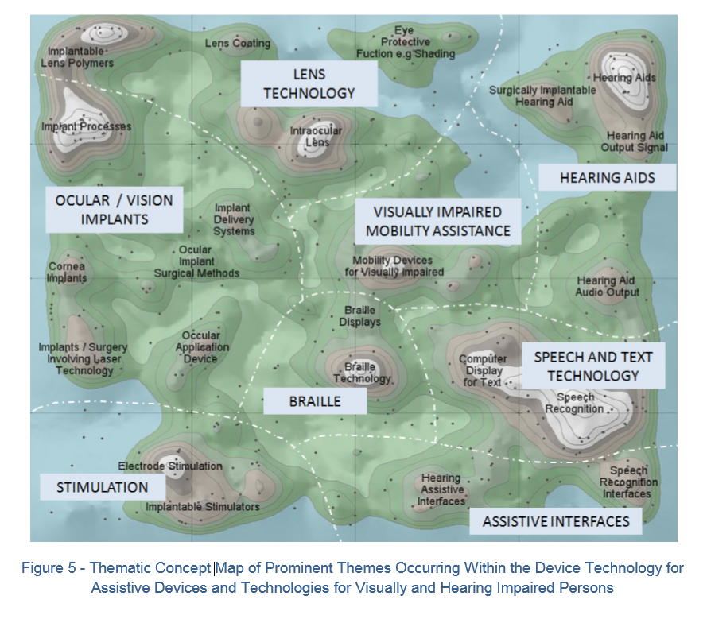
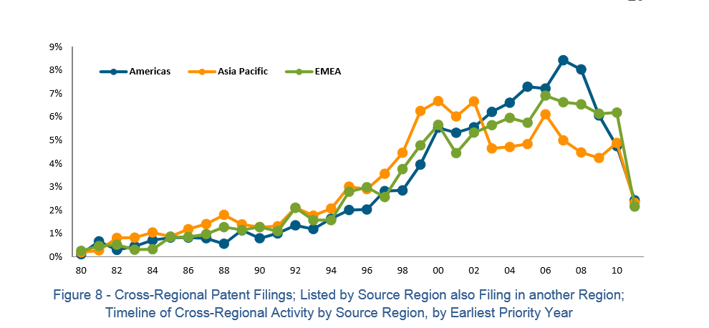
Patent Landscaping as a tool to calculate IP Risk and a component of Market Risk

Slide 53
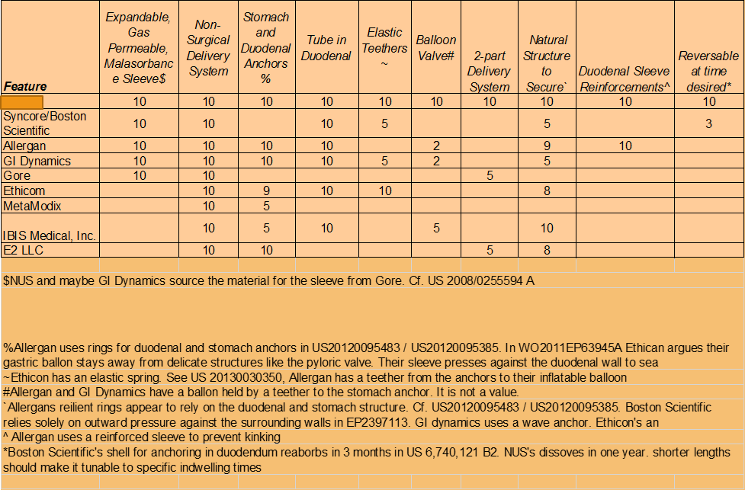
Non-Surgical obesity reduction devices

Slide 54
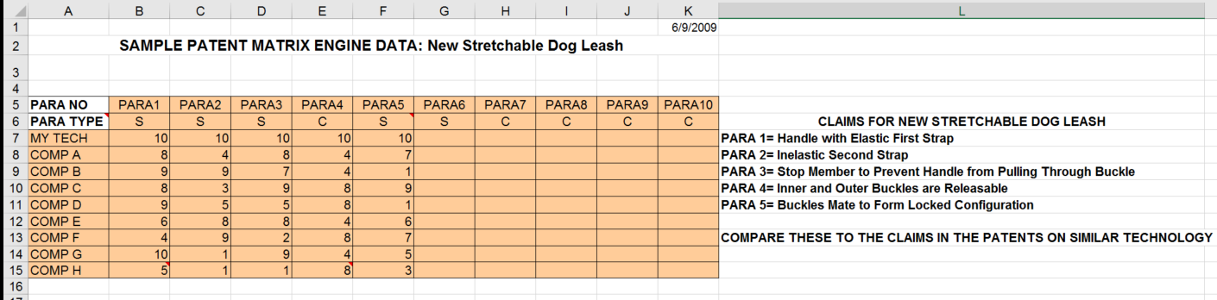
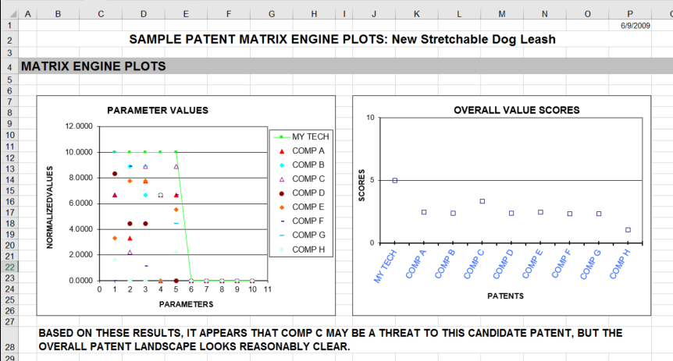
Potential Technical Competitive Advantage

Slide 55
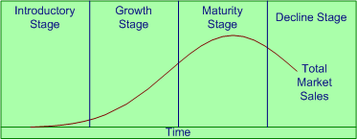
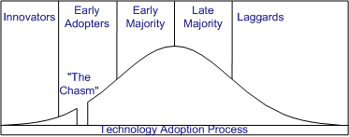
As a tool to calculate market risk

Slide 56
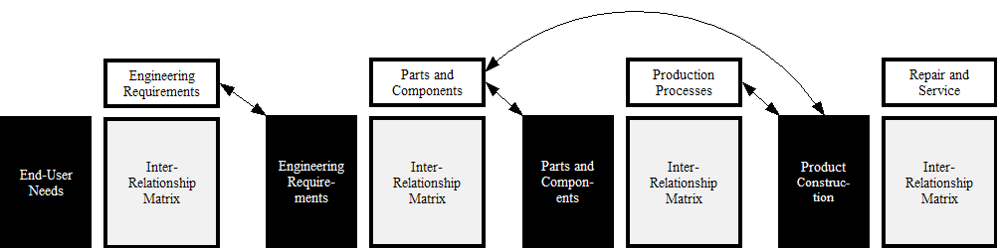
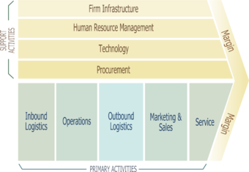
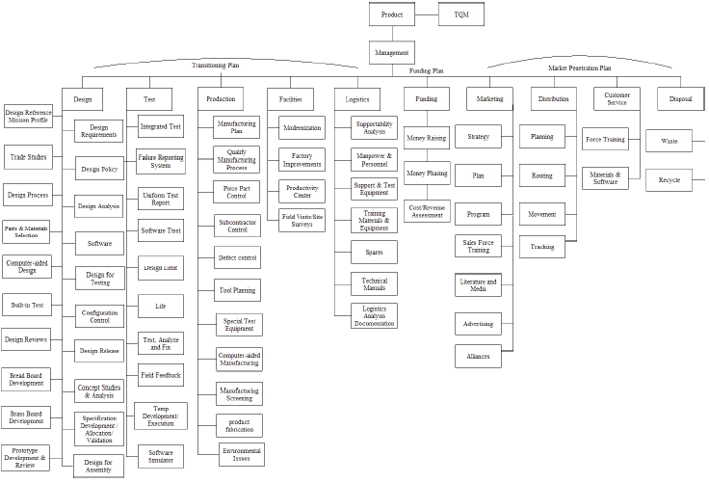
Firm Specific Risk follows

Slide 57
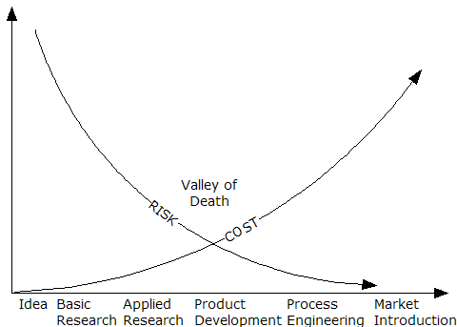
Technical Risk reflects the TRL and research team
TRL
Research Team
Bibliometric analysis of
  Patent citations
  Research citations
  Funding and other awards

Slide 58
Mitigating or Avoiding Risks Raises the Value
Targets and Means Matrix
Objectives
Action Plan
Objective 1 (Reduce/Increase)
Objective 3
Time Line
Objective 4
Objective 2
Objective 5
Resources
Measure
Required
Who?
J F M A M J J A S O N D
Task 1
Task 2
Task 3
Task 4
Task 5
Progress
58

Slide 59
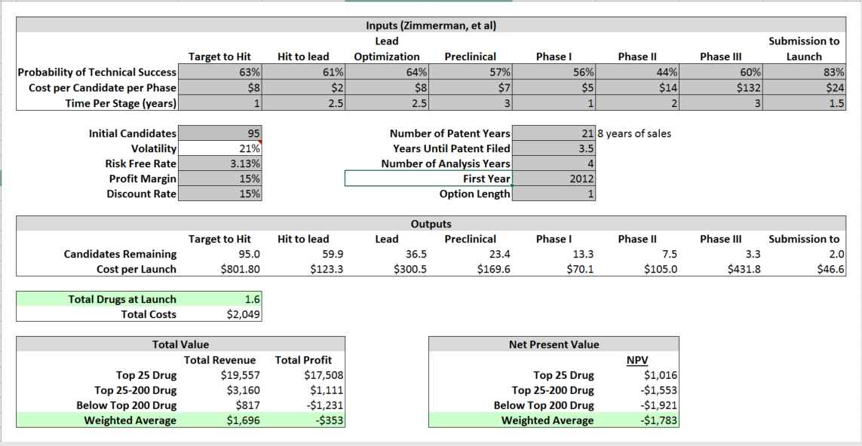
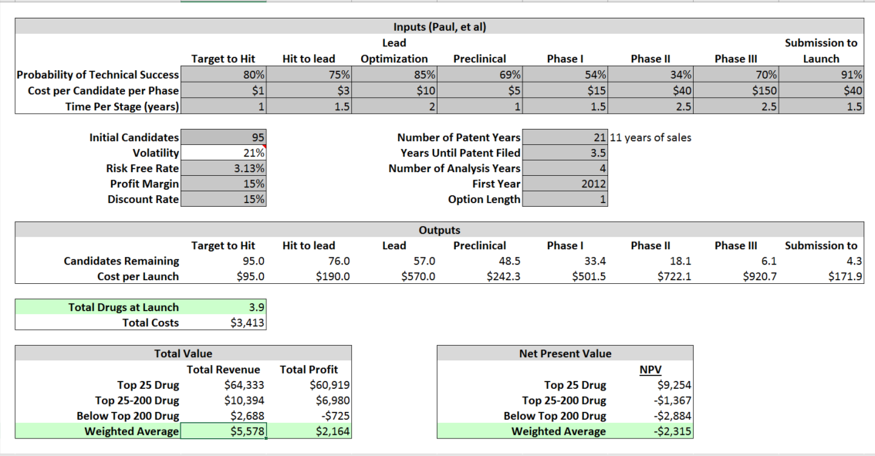
Pharma NPV Calculation

Slide 60
Getting to the Big Money
IP on the Balance Sheet

Slide 61

IP/Technology on a balance sheet is an option value
Low
Likelihood of receiving new information
High
High
U n c e r t a i n t y
High
Flexibility Value
Moderate
Flexibility Value
Room for
Managerial Flexibility
Ability to respond
Low
Flexibility Value
Moderate
Flexibility Value
Low
Marco Antonio Guimarães Dias, Petrobras and PUC-Rio, Brazil, 2003,www.puc-rio.br/marco.ind/

Slide 62
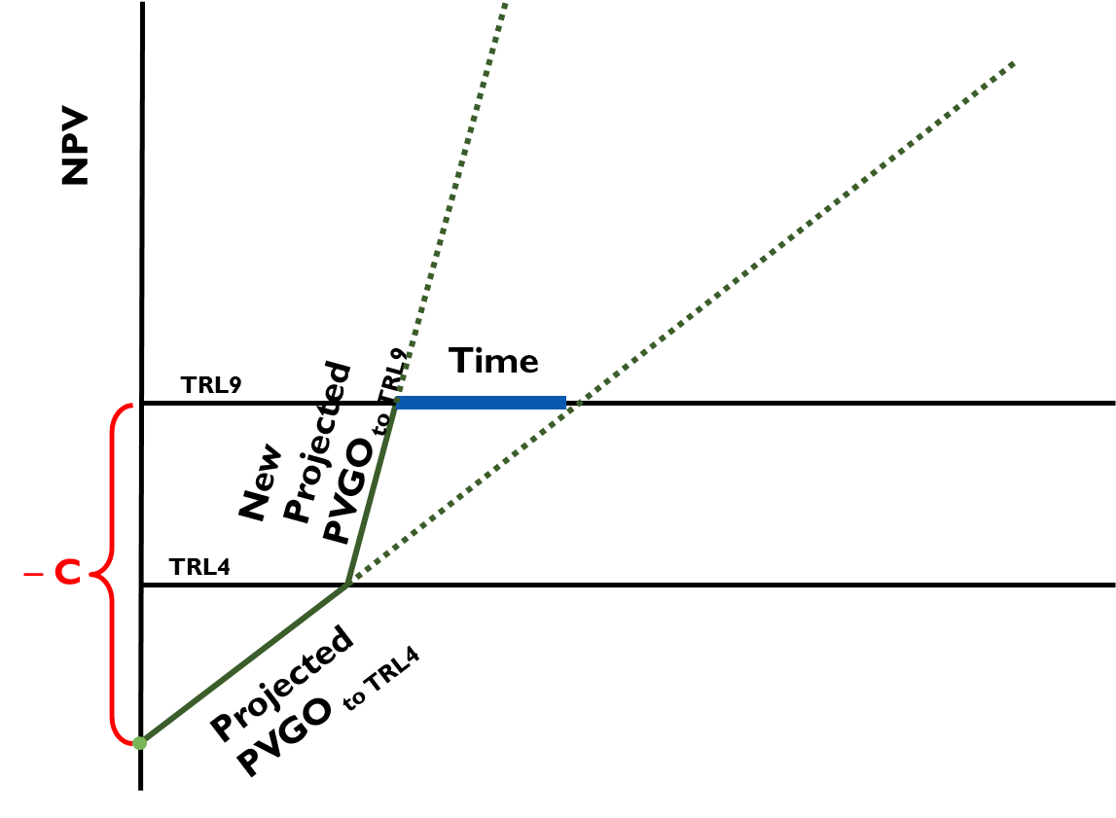
PVGO
62

Slide 63
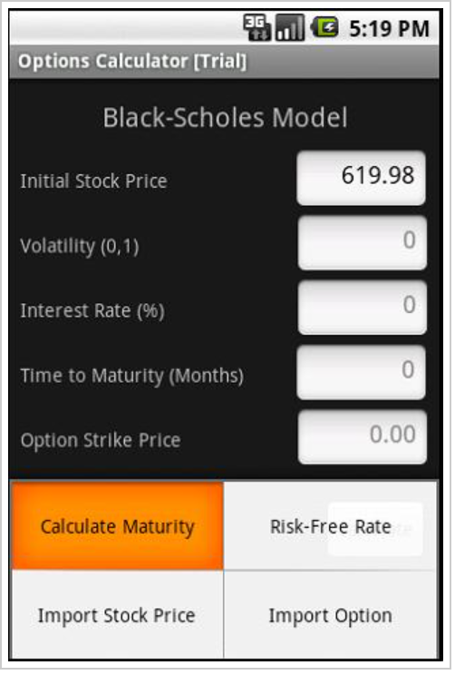
The Balance Sheet value is the impact on the stock option price
IP changes volatility from
the expected industry norm

Slide 64
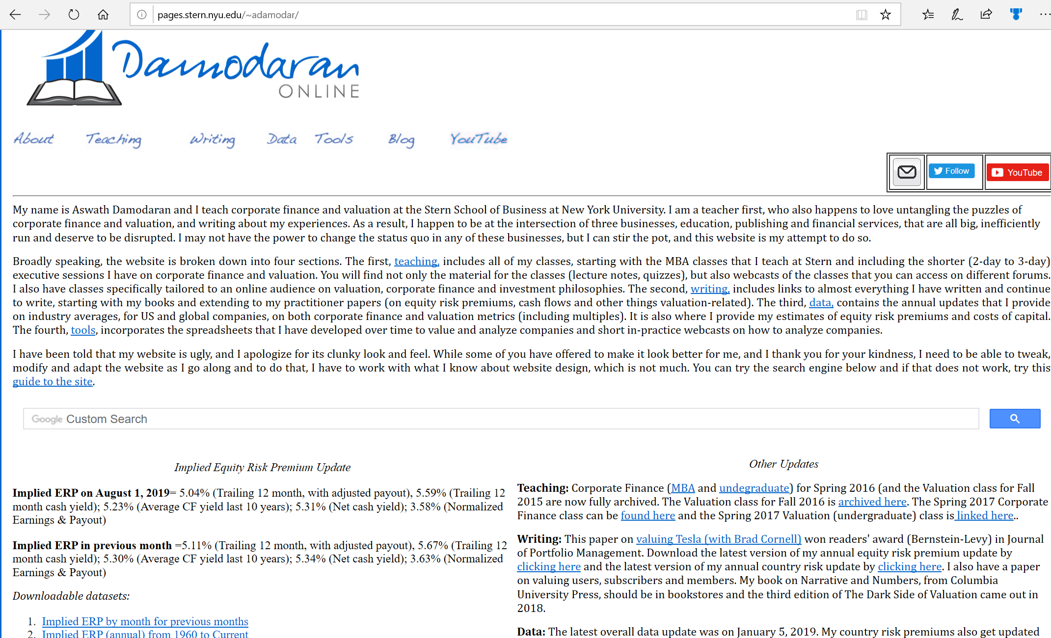

Slide 65
Tip Nine
The value of IP/technology is the sum of its income statement and balance sheet values

Slide 66
Tip Ten
Nothing happens without a sale.
David Speser
The value of IP/Technology is tied to the sale of product or stock.
If opportunity doesn’t knock, build a door.
Milton Berle
The value will vary by company so part of the job is to choose the best company to use in your calculations.
A well-defined imagination is the source of great deeds.
Chinese Fortune Cookie
The techniques used reflect your objectives and budget.

